Slide 1








WaveCon5G
Telecom Analysis
WaveCon: Powering 5G Future
Presentation
Presented By:
Vkas Rajpurohit

Slide 2


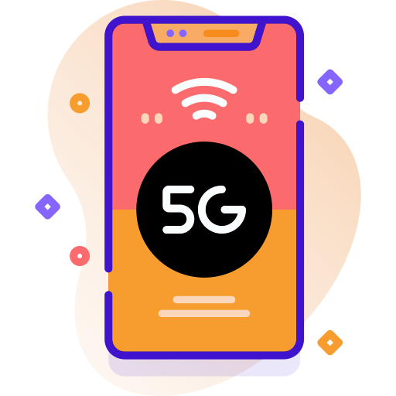
Overview
Introduction
Intractive PowerBI Dashboard
Impact of 5G launch on Revenue
Underperforming KPI after 5G launch
5G plans performance
Plans affected by 5G launch
Discontinued plans after 5G launch

Slide 3




INTRODUCTION
WaveCon leads the charge in 5G innovation, redefining connectivity for the future with lightning-fast speeds and unparalleled reliability with more than 161.7 million active users, holding a market share of 17.84 % as of Sep2023.
Calle Cualquiera 123, Cualquier Lugar
WAVECON5G.CO

Slide 4

POWERBI DASHBOARD
WAVECON5G.CO

Slide 9
PLAN PERFORMANCE AFTER 5G LAUNCH
Smart Recharge Pack is the best performing plan generating highest revenue.
Smart Recharge Pack
2.40 BN
P1
2GB/Day
Data
3 Months
Validity
Olivia Wilson
+10K
25GB 3G/4G Combo Pack
25GB 3G/4G Combo Pack is the least performing plan generating lowest revenue.
5.60 MN
7.00 MN
P7
25GB
Data
3 Months
Validity
155.6 MN

Slide 10
PLAN AFFECTED AFTER 5G LAUNCH
25GB 3G/4G Combo Pack is the least performing plan generating lowest revenue.
Smart Recharge Pack
155.6 MN
3 Months
Validity
2.40 BN
P1
2GB/Day
Data
Olivia Wilson
SUGGESTION
25GB 3G/4G Combo Pack
P7
25GB
Data
3 Months
Validity
Completely discontinue 3G plan, whereas continue offering 4G plan.
Not everyone has 5G handset/device.

Slide 11
Improvement Plan
Create impactful marketing for brand promotion.
Create attractive 5G affordable and combo plans, and discontinue 3G plans.
Improve 5G network quality and introduce new 5G compatible devices and services.
2.40 BN

Slide 12

2.40 BN
THANK YOU..!

